Slide 1
Resolving IP Connectivity Issues
Lesson 2

Slide 2
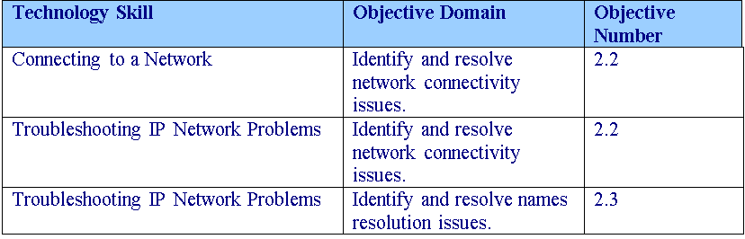
Objectives
Notes:
Outline the material you are going to cover in this lesson. Do not go into detail; each of these points will be expanded on in the lesson. You may also want to mention the Technology Skills that are being covered for the Certification exam.

Slide 3
Connecting to a Network
The most common cabling system used for wired computers is Ethernet.
Most computers that use Ethernet connect with unshielded twisted-pair (UTP) cabling.
Each end of the UTP cable has RJ-45 connectors.
Today’s workstations usually come with 100 Mb/s or 1 Gb/s connections for Ethernet, while some older machines only support 10 Mb/s.

Slide 4
Connecting to a Network
If a client cannot communicate over the network, you should first check to make sure that the cable is firmly connected to the network.
You should also look at the indicator lights on the network card or interface and the lights on the switch or hub to determine what the LEDs are telling you.
If you have no lights on the switch or hub, make sure that the switch or hub has power and is turned on.

Slide 5
TCP/IP
Since the Internet has become so popular, so has the TCP/IP protocol suite that the Internet runs on.
One of the two main protocols mentioned in the name, is the IP protocol that is responsible for addressing and routing packets between hosts.
Each host must have its own unique IP address so that it can send and receive packets.

Slide 6
Host and IP addresses
A host is any device that connects directly to a network.
While most hosts are computers, they can also include network printers, routers, layer 3 switches, managed switches, and any other device that has a network card or interface.
An Internet Protocol (IP) address is a logical address and numerical label that is assigned to a device that is connected to a computer network.
While you have to follow certain guidelines based on the TCP/IP protocol suite, they are logical addresses that you assign as needed.

Slide 7
IP Addresses
Today, most IP addresses are based on the traditional IPv4 addresses, which are based on 32-bit numbers.
Unfortunately, since the Internet has grown in popularity, the 4 billion addresses used on an IPv4 network are almost depleted.
IPv6 addresses, which are based on 128-bit addresses.
Since each bit doubles the number of available addresses, the 128-bit addresses allow up to 3.403 × 10³⁸ addresses.

Slide 8
IP Addresses
When shown, an IPv4 address is expressed in dot-decimal notation consisting of four numbers (w.x.y.z), each ranging from 0 to 255. Each number is called an octet because it is based on 8 bits.
Examples of IPv4 addresses are:
192.168.1.1
16.23.212.214
127.0.0.1

Slide 9
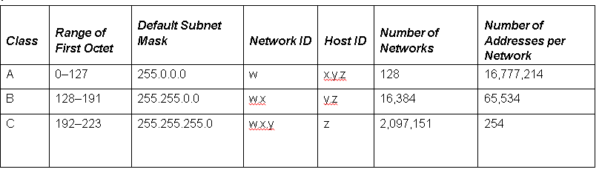
IPv4 Classful Address
The earliest IPv4 addresses were based on a classful network design where the first three bits of the first octet would define the class—class A, B, and C.

Slide 10
Subnet Mask
The subnet masks specify which bits are network bits and which bits are host bits.
When you have a subnet mask of 255.0.0.0, it means that the first 8 bits are used to describe the network bits while the last 24 bits are used for the host bits.
Therefore, if you have a 12.212.34.5 address with a subnet mask of 255.0.0.0, you have a 12.0.00 network address and a 12.212.34.5 host address.

Slide 11
Classless Addressing
Unfortunately, with a classful network, many addresses were wasted.
Therefore, classless inter-domain routing (CIDR) was developed to utilize the networks more efficiently.
Instead of using the pre-defined subnet masks, CIDR is based on variable-length subnet masking (VLSM) where you can take a network and subdivide the network into smaller subnets.

Slide 12
Network Address Translation
Network address translation (NAT) is used with masquerading to hide an entire address space behind a single IP address.
In other words, it allows multiple computers on a network to connect to the Internet through a single IP address.

Slide 13
Private Addresses
The private addresses are reserved addresses not allocated to any specific organization.
Since these private addresses cannot be assigned to global addresses used on the Internet and are not routable on the Internet, you must use a NAT gateway or proxy server to convert between private and public addresses.

Slide 14
Private Addresses
These are private network addresses as expressed in RFC 1918:
10.0.0.0–10.255.255.255
172.16.0.0–172.31.255.255
192.168.0.0–192.168.255.255

Slide 15
IPv6 Addresses
IPv6 provides a number of benefits for TCP/IP-based networking connectivity, including:
128-bit address space to provide addressing for every device on the Internet with a globally unique address.
Allows for more efficient routing than IPv4.
Support for automatic configuration.
Enhanced security to protect against address and port scanning attacks and utilize IPSec to protect IPv6 traffic.

Slide 16
IPv6 Addresses
Since the IPv6 uses 128 bits, the addresses are usually divided into groups of 16 bits, written as 4 hex digits.
Hex digits include 0, 1, 2, 3, 4, 5, 6, 7, 8, 9, A, B, C, D, E, and F. The groups are separated by colons. Here is an example of an address
FE80:0000:0000:0000:02C3:B2DF:FEA5:E4F1

Slide 17
IPv6 Addresses
With IPv6, you still have unicast and multicast addressing. However, unicast addressing can be divided into:
Global unicast address
Link-local addresses
Unique local addresses

Slide 18
Global Unicast Address
Public addresses that are globally routable and reachable on the IPv6 portion of the Internet.

Slide 19
Link-local Addresses
Private non-routable addresses confined to a single subnet.
They are used by hosts when communicating with neighboring hosts on the same link but can also be used to create temporary networks for conferences or meetings, or set up a permanent small LAN.
Routers process packets destined for a link-local address, but they will not forward them to other links.

Slide 20
Unique Local Addresses
Meant for private addressing, with the addition of being unique, so that joining two subnets does not cause address collisions.

Slide 21
Default Gateway
A default gateway is a device, usually a router, which connects the local network to other networks.
When you need to communicate with a host on another subnet, you forward all packets to the default gateway.

Slide 22
Name Resolution
In today’s networks, you assign logical addresses such as IP addressing. Unfortunately, these addresses tend to be hard to remember, especially with the newer more complicated IPv6 addresses.
Therefore, you need to use some form of naming service that will allow you to translate logical names, which are easier to remember, to those logical addresses.

Slide 23
HOST and LHMOST Files
Early TCP/IP networks used hosts (used with domain/host names associated with DNS) and lmhost (used with NetBIOS/Computer names associated with WINS) files, which were text files that would list a name and its associated IP address.
In Windows, both of these files are located in the C:\Windows\system32\drivers\etc folder.

Slide 24
Domain Name System
Besides becoming the standard for the Internet, DNS, short for Domain Name System, is a hierarchical client/server-based distributed database management systems that translates domain/host names to an IP address.
In other words, while you may have a DNS server (or several servers), sometimes referred to as name servers, for your organization to provide naming resolution for you organization, all of the DNS servers on the Internet are linked together to provide worldwide naming resolution that allows you to manage the DNS for you organization.

Slide 25
WINS
Another name resolution technology is Windows Internet Name Service or WINS, which translates from NetBIOS (computer name) to specify a network resource.
Since the growth of the Internet and the scalability of DNS, WINS is considered a legacy system.

Slide 26
Network and Sharing Center
Network and Sharing Center provides real-time status information about your network.
It can be used to configure and manage your network connections including managing your wireless networks, the type of connections you have, and the level of access you have to other computers and devices on the network.
It can also be used to help troubleshoot network connectivity problems by providing detailed information about your network in the network map.

Slide 27
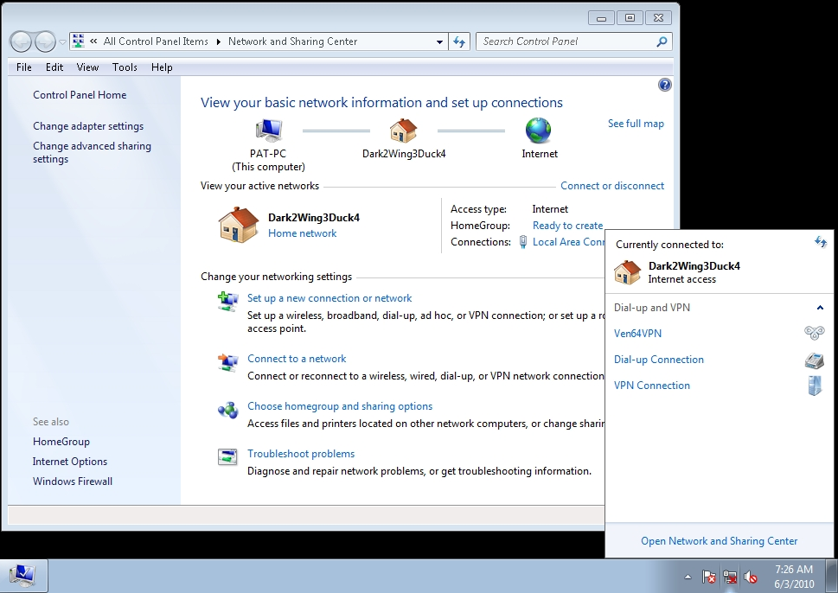
Network and Sharing Center

Slide 28
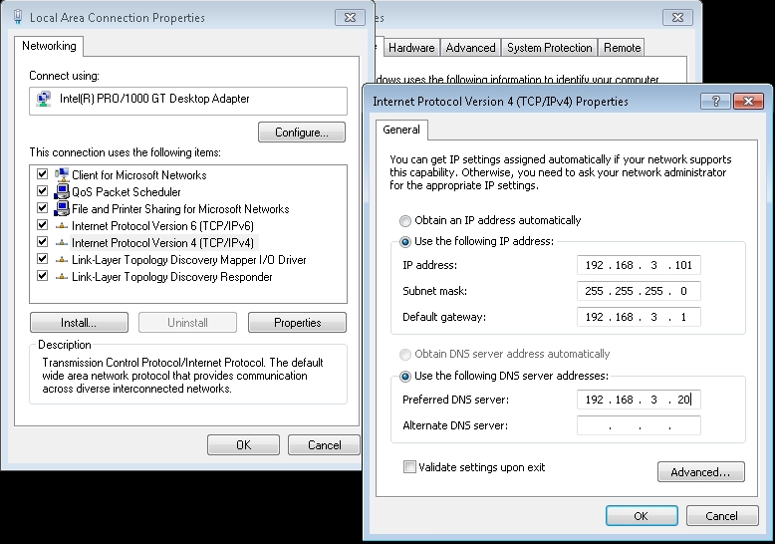
Configuring IPv4

Slide 29
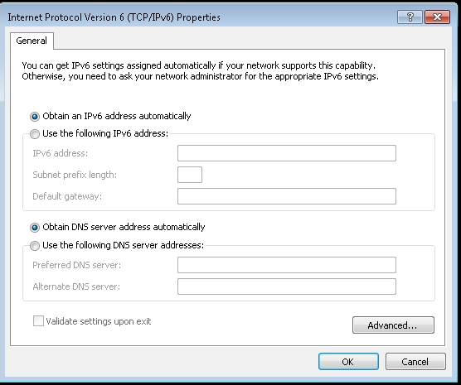
Configuring IPv6

Slide 30
Managing Network Discovery and Sharing Services
The Network and Sharing Center also allows you to configure certain network services such as network discovery and sharing. These settings include:
Network discovery
File and printer sharing
Public folder sharing
Media streaming
Password protected sharing

Slide 31
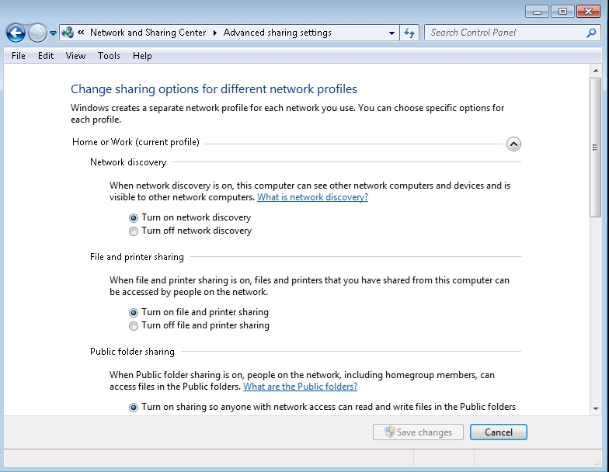
Managing Network Discovery and Sharing Services

Slide 32
Ports
A host uses ports to identify which packets belong to a network service or program.
You can have a total of 65,535 TCP ports and another 65,535 UDP ports.

Slide 33
Common Ports
DNS: TCP/UDP port 53
FTP: TCP port 20 and 21
HTTP: TCP port 80
HTTPS: TCP port 443
IMAP: TCP/UDP port 143
LDAP: TCP port 389
POP3: TCP port 110
SMTP: TCP/UDP port 25
Telnet: TCP/UDP port 23

Slide 34
Troubleshooting IP Network Problems
If the problem still exists, you can also use the following command-line tools:
ipconfig
ping
tracert
pathping
netstat
telnet
nslookup

Slide 35
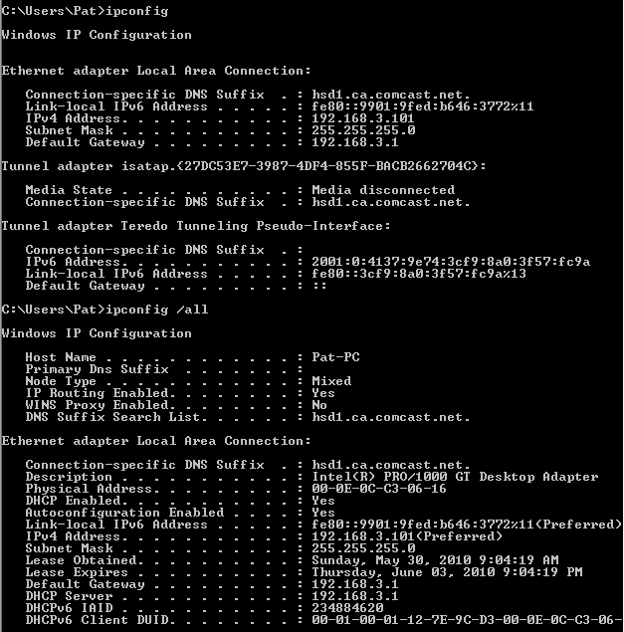
IPConfig Command

Slide 36
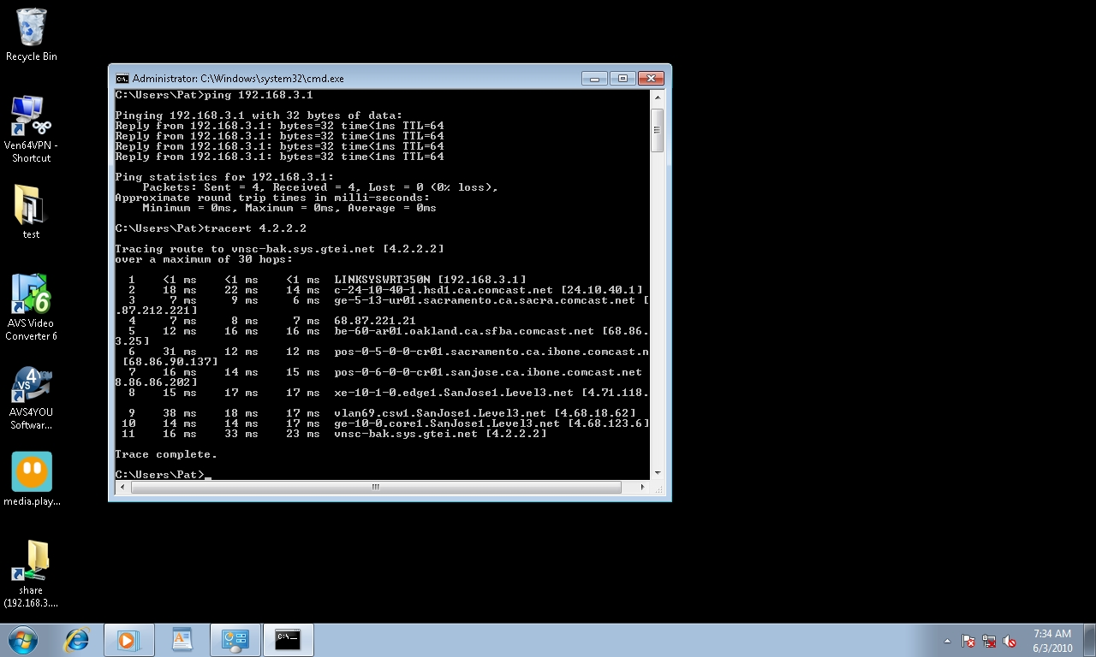
PING Command

Slide 37
Tracert Command

Slide 38
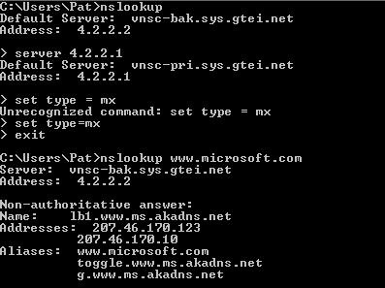
Nslookup

Slide 39
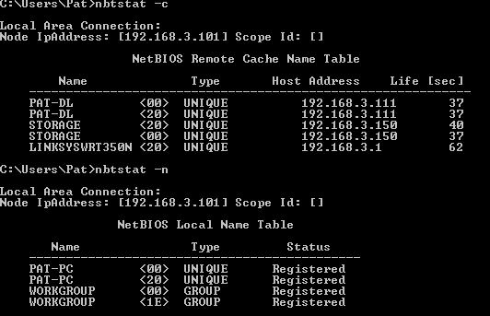
Nbtstat

Slide 40
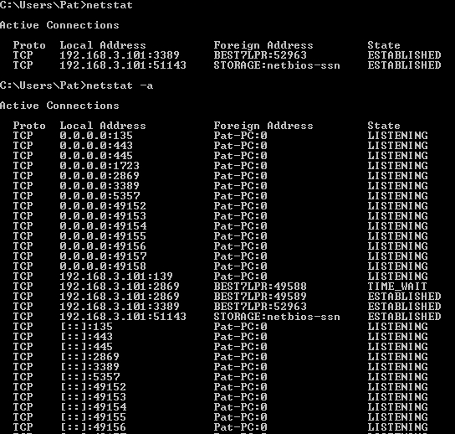
Netstat

Slide 41
Skill Summary
When diagnosing network problems, you must first determine the extent of the problem including whether it affects one host or multiple hosts. This will help you determine where to focus your attention.
If the problem only affects one computer on a subnet, the problem is most likely with the computer itself, the network interface, or the cable that connects them to the switch or hub.

Slide 42
Skill Summary
If the problem is affecting more than one computer, you need to look for a centralized component to those computers.
A host is any device that connects directly to a network.
An Internet Protocol (IP) address is a logical address and numerical label that is assigned to a device connected to a computer network.
Notes:
Review the Skill Summary to wrap up your lesson.

Slide 43
Skill Summary
Today, most IP addresses are based on the traditional IPv4 addresses that are based on 32-bit numbers.
The earliest IPv4 addresses used a classful network design where the first three bits of the first octet defined the class—class A, B, and C.
The subnet masks specify which bits are network bits and which are host bits.

Slide 44
Skill Summary
Classless inter-domain routing (CIDR) was developed to utilize the networks more efficiently. Instead of using the pre-defined subnet masks, CIDR is based on variable-length subnet masking (VLSM) where you can take a network and subdivide the network into smaller subnets.

Slide 45
Skill Summary
Network address translation (NAT) is used with masquerading to hide an entire address space behind a single IP address.
In other words, it allows multiple computers on a network to connect to the Internet through a single IP address.
Private addresses are reserved addresses not allocated to any specific organization.
Since these private addresses cannot be assigned to global addresses used on the Internet, you must use a NAT gateway or proxy server to convert between private and public addresses.

Slide 46
Skill Summary
IPv6 provides a number of benefits for TCP/IP-based networking connectivity, including 128-bit address space to provide addressing for every device on the Internet with a globally unique address.

Slide 47
Skill Summary
A default gateway is a device, usually a router, that connects the local network to other networks. In today’s networks, you assign logical addresses such as IP addressing. Unfortunately, these addresses tend to be hard to remember.

Slide 48
Skill Summary
DNS, short for Domain Name System, is a hierarchical client/server based distributed database management systems that translates domain/hosts names to an IP address.
Another name resolution technology is Windows Internet Name Service or WINS, which translates from NetBIOS (computer name) to specify a network resource. Since the growth of the Internet and the scalability of DNS, WINS is considered a legacy system.

Slide 49
Skill Summary
The Network and Sharing Center provides real-time status information about your network.
It can be used to configure and manage your network connections including managing your wireless networks, connection types, and the level of access you have to other computers and devices on the network.
Network discovery allows this computer to see other network computers and devices and makes it visible to other network computers.

Slide 50
Skill Summary
To identify which packets belong to a network service or program, a host uses ports.

Slide 51
Skill Summary
If a computer is configured to receive an IP address from a DHCP server and one does not respond, the computer will use the Automatic Private IP addressing, which generates an IP address in the form of 169.254.xxx.xxx and the subnet mask of 255.255.0.0.
The ipconfig command, one of the most useful commands when troubleshooting network problems, displays all current TCP/IP network configuration values and refreshes Dynamic Host Configuration Protocol (DHCP) and Domain Name System (DNS) settings.

Slide 52
Skill Summary
The ping command verifies IP-level connectivity to another TCP/IP computer by sending Internet Control Message Protocol (ICMP) Echo Request messages.
Nslookup.exe is a command-line administrative tool for testing and troubleshooting DNS name resolution.

